Slide 1
Numerical simulation
of a transmon qubit
NUMERICAL METHODS · PROJECT
Test 1 — Parts 1 to 3: energy levels, driven dynamics, dissipation
Anders Worm · UTS Sydney
Notes:
Hi, my name is Anders Worm, and this is my walkthrough of test 1 in my numerical methods project, where I simulate a superconducting transmon qubit. A quick note on the format: all the code was written and run on the university’s lab computer, which I can’t move, and I’m not able to record audio there. So I recorded the screen without sound at the lab and added this voice-over afterwards. Test 1 covers the first three parts of the project: the energy levels, the driven qubit, and dissipation.

Slide 2
Transmon Hamiltonian on a phase grid
PART 1 · CODE
# Part1.py
def SD2(N, h):
M = N-1
AD = np.diag(-2*np.ones(N), 0)
AO = np.diag(np.ones(M), 1)
AL = np.diag(np.ones(M), -1)
AP = np.diag([1], M) + np.diag([1], -M)
D2 = sp.csr_matrix((AD+AO+AL+AP)/h**2)
return(D2)
def transmon_H(N, h, E_j, E_c, phi):
H = -4*E_c*SD2(N,h) - E_j*SV(phi)
# test1.py
E, U = sla.eigsh(H, k=3, which='SA')
Hamiltonian
H = −4E_C d²/dφ² − E_J cos φ
E_J / E_C = 50
Periodic boundary
φ = −π and φ = π.
Sparse + eigsh
1000 grid points, only the 3 lowest states are found.
Test 1 · Part 1 · 2
Notes:
Part one starts from the transmon Hamiltonian: minus four E-c times the second derivative in phi, minus E-J cos phi. I put phi on a grid of a thousand points. The second derivative becomes a tridiagonal matrix, and the two extra corner elements in AP make the boundary periodic, because phi is an angle. The cosine term is just a diagonal matrix. Everything is stored as sparse matrices, and eigsh finds only the three lowest eigenvalues, so I never diagonalise the full thousand-by-thousand matrix.

Slide 3
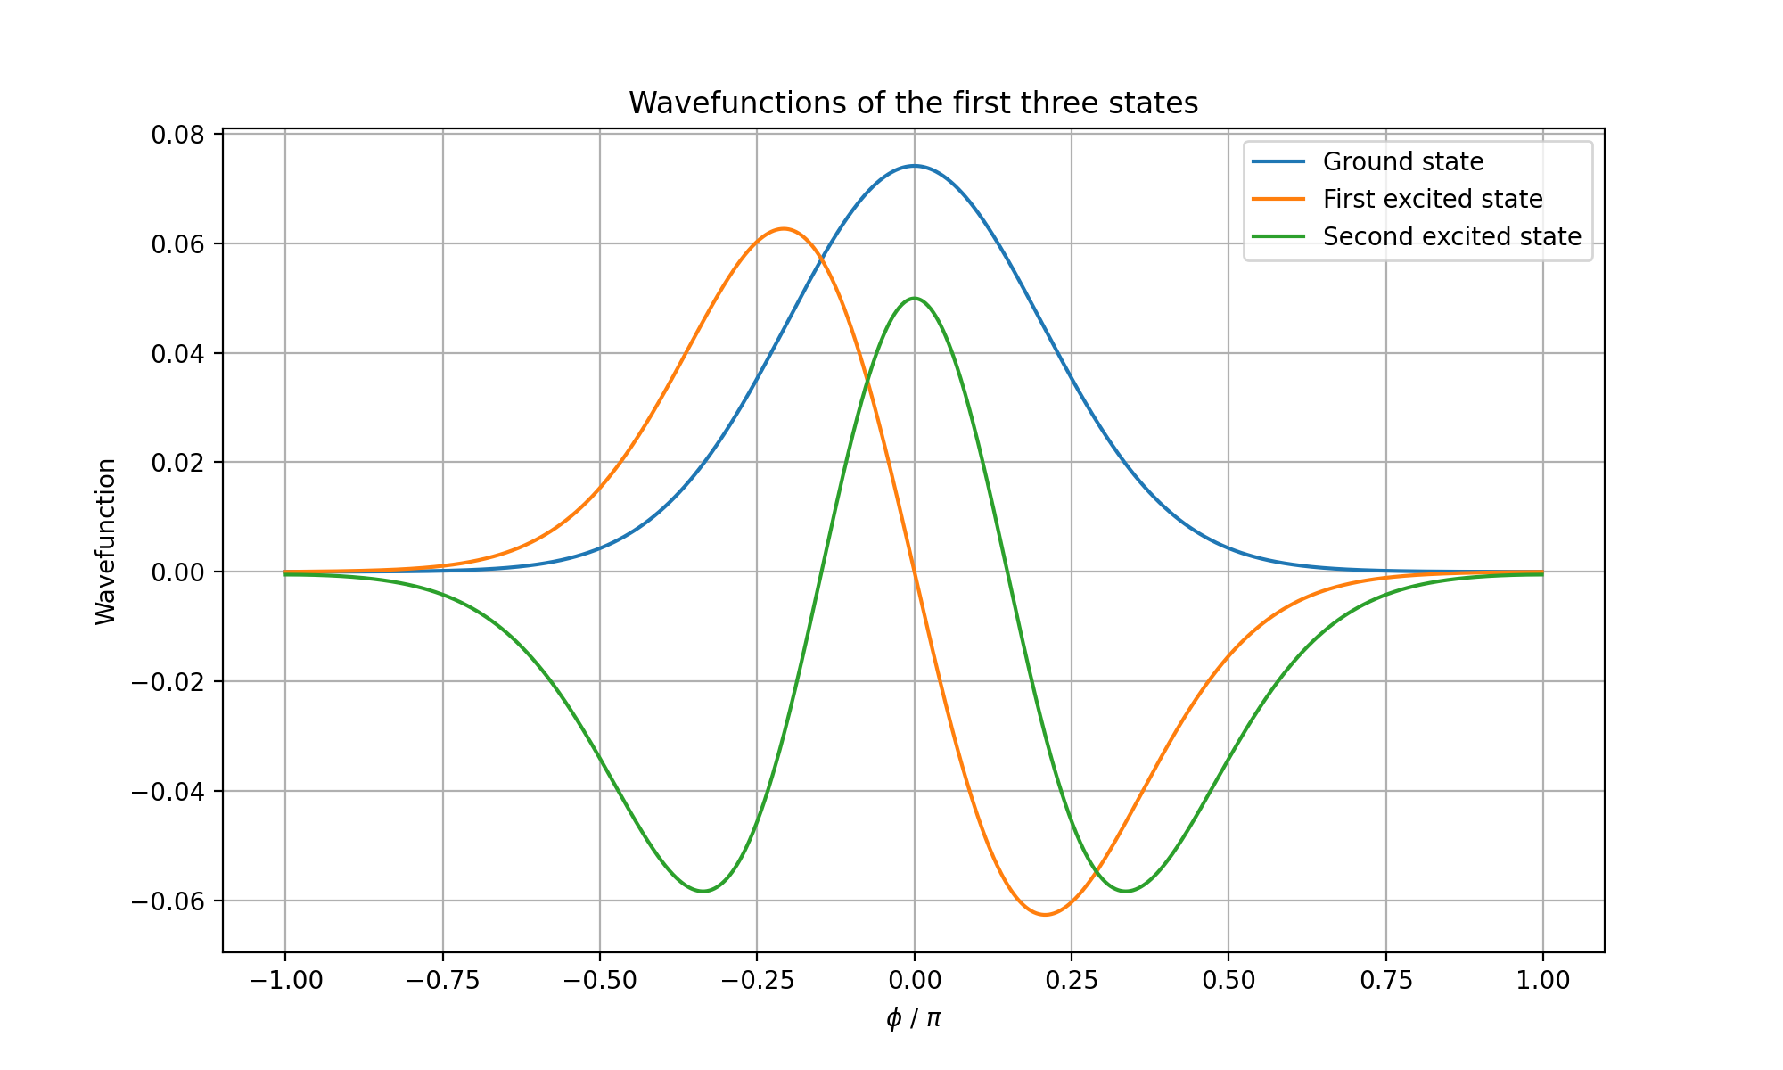
Three lowest states and an anharmonic ladder
PART 1 · RESULT
Gap 0 → 1
4.74 GHz
Gap 1 → 2
4.45 GHz
Anharmonicity
−0.29 GHz
close to −E_C = −0.25 GHz
Test 1 · Part 1 · 3
Notes:
Here are the three lowest wavefunctions. Because E-J is fifty times E-c, they are localised around phi equals zero and look like harmonic-oscillator states, with zero, one and two nodes. But the levels are not evenly spaced. The zero-to-one gap is 4.74 gigahertz and the one-to-two gap is 4.45 gigahertz, so the anharmonicity is about minus 0.29 gigahertz, close to minus E-c, as theory predicts. That anharmonicity is what lets us drive only the lowest transition and use the transmon as a qubit.

Slide 4
Charge basis, three levels and a drive
PART 2 · CODE
# part2.py
def H_number(N, Ec, Ej):
K = 4*Ec*np.diag(N**2, 0)
V = -Ej/2*(np.diag(np.ones(M), 1)
+ np.diag(np.ones(M), -1))
def H_drive(t, omega, w, A):
return(omega*np.sin(w*t)*A)
# test1.py
E, U = sla.eigsh(H_num, k=3, which='SA')
H_0 = np.diag(E, 0) - E[0]*np.eye(3)
w = E[1]-E[0]
A = U.T @ np.diag(N) @ U
def f(t, c):
return(-1j*H_time(t,H_0,A,omega,w)@c)
t, C = rk4solve(f, c0, 0, 0.005, 25)
n = −10 … 10
cos φ becomes a nearest-neighbour coupling.
Truncate to 3 levels
A = charge operator in the eigenbasis.
Own RK4 solver
dc/dt = −i H(t) c, step 0.005 ns.
Test 1 · Part 2 · 4
Notes:
For the dynamics I switch to the charge basis, with the number of Cooper pairs from minus ten to ten. Here the cosine becomes a simple nearest-neighbour coupling. I keep only the three lowest eigenstates, shift the ground-state energy to zero, and write the charge operator in that basis. That is the coupling matrix A. The drive adds omega times sin of w t times A, with w set to the qubit frequency. The Schrödinger equation then becomes a set of ordinary differential equations, which I solve with my own RK4 solver.

Slide 5
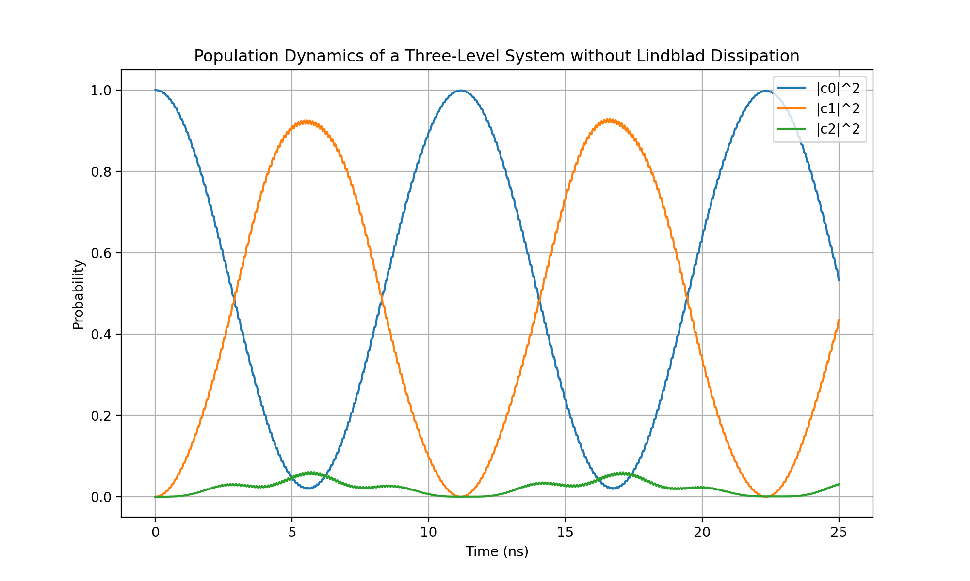
Rabi oscillations without dissipation
PART 2 · RESULT
0 ↔ 1 and back
Period ≈ 11 ns. P1 peaks at ≈ 0.92.
Leakage to level 2
Strong drive (E_C/3) vs. the anharmonicity: P2 up to ≈ 0.06.
Fast ripples
No rotating-wave approximation.
Test 1 · Part 2 · 5
Notes:
The result is Rabi oscillations: the population moves from the ground state to the first excited state and back, with a period of about eleven nanoseconds. It doesn’t quite reach one, because the drive amplitude is a third of E-c, which is strong compared to the anharmonicity, so some population leaks into the second excited state — the green curve. The small fast ripples on the curves come from the fact that I don’t use the rotating-wave approximation.

Slide 6
Lindblad master equation
PART 3 · CODE
# part3.py
def Dissipation(T, rho, gamma):
return gamma*T@rho@T.conj().T
- 0.5*gamma*(T.conj().T@T@rho
+ rho@T.conj().T@T)
def Lindblad(T, rho, H, gamma):
return -1j*(H@rho - rho@H)
+ Dissipation(T1, rho, gamma1)
+ Dissipation(T2, rho, gamma2)
# test1.py
t1, t2 = 200, 150 # ns
gamma = np.array([1/t1, 2*(1/t2 - 1/(2*t1))])
T1 = [[0,1,0],[0,0,√2],[0,0,0]] # a
T2 = np.diag([0,1,2]) # a†a
State → density matrix
Same RK4 solver, now on ρ.
a → relaxation
Rate γ1 = 1/T1.
a†a → dephasing
γ2 chosen so coherence decays at exactly 1/T2.
Test 1 · Part 3 · 6
Notes:
In part three the state becomes a density matrix, and I solve the Lindblad master equation with the same RK4 solver. The Lindblad function is the commutator with the Hamiltonian plus one dissipator for each jump operator. The lowering operator a gives relaxation, with rate one over T1. The operator a-dagger-a gives pure dephasing. Its rate is chosen so that the coherence decays at exactly one over T2, taking into account that relaxation already contributes half of its own rate to the coherence. I use T1 equal to 200 and T2 equal to 150 nanoseconds.

Slide 7
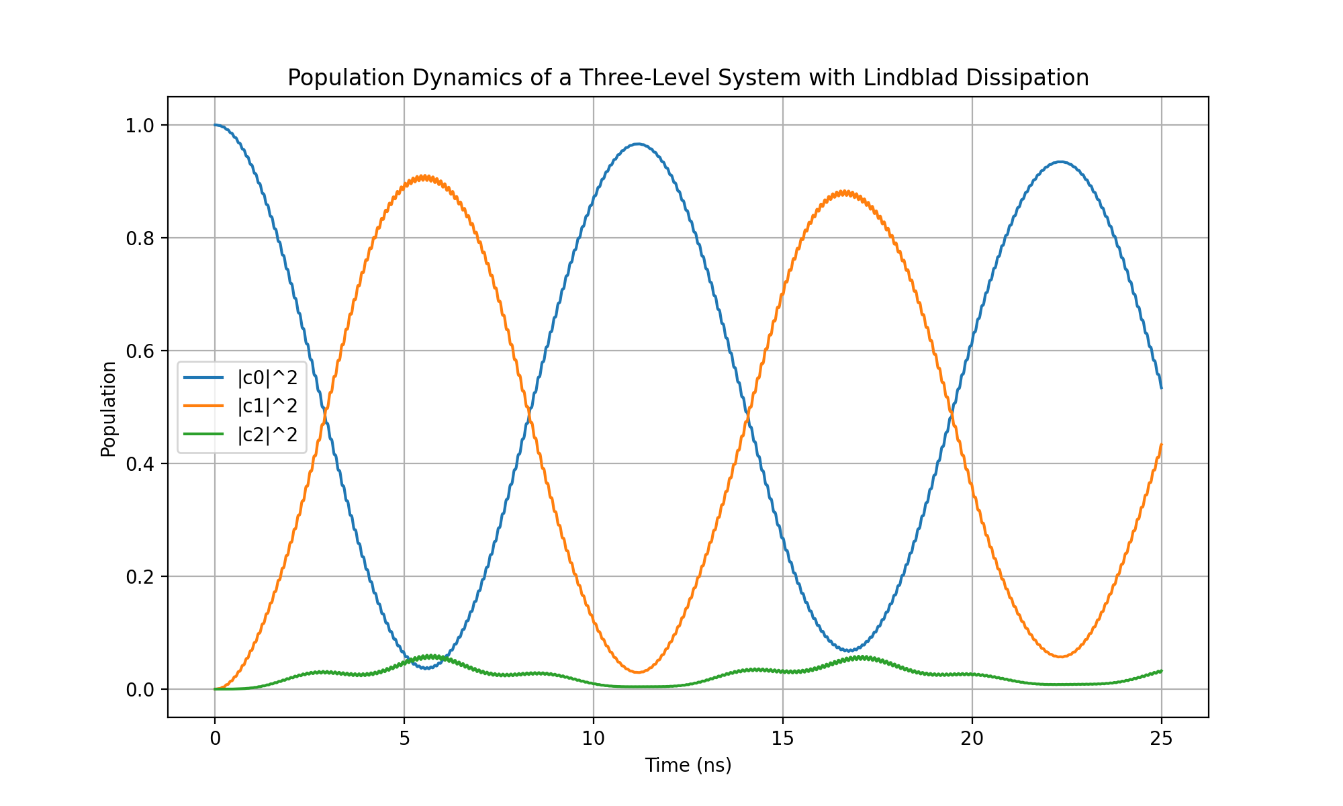
Oscillations slowly lose contrast
PART 3 · RESULT
Peaks shrink
P1: ≈ 0.91 → 0.88. P0 no longer returns to 1.
Small over 25 ns
T1 = 200 ns and T2 = 150 ns are much longer.
Long run
Drifts toward a mixed state.
Test 1 · Part 3 · 7
Notes:
With dissipation, the oscillations slowly lose contrast. The peaks get a little lower every period, and the ground-state population no longer returns all the way to one. Over 25 nanoseconds the effect is small, because T1 and T2 are much longer, but it is clearly visible compared to part two. Run for longer, the system drifts toward a mixed state.

Slide 8
Test 1 builds the qubit from scratch
PART 1
PART 2
PART 3
Energy levels and anharmonicity
Driven three-level system with RK4
Open system with T1 and T2
Next, test 2: optimising a π-pulse and extracting T1 and T2 from simulated measurements.
Notes:
So test 1 builds the qubit from scratch: the energy levels, a driven three-level system, and an open-system model with relaxation and dephasing. Test 2 builds on these parts to optimise a pi-pulse and to extract T1 and T2 from simulated measurements. Thanks for watching.

